Slide 1

Password Strength Analyzer
This presentation explores creating a password strength analyzer in Excel.
We'll examine how Excel can help secure sensitive data, given the rise in cybersecurity threats.

Slide 2

Understanding the Analyzer
A password strength analyzer evaluates password complexity. It identifies weak passwords, aligning with NIST standards.
Complexity Evaluation
Weak Password Detection
Analyzes passwords based on various factors.
Flags passwords that are easily crackable.
NIST Alignment
Ensures compliance with security standards.

Slide 3
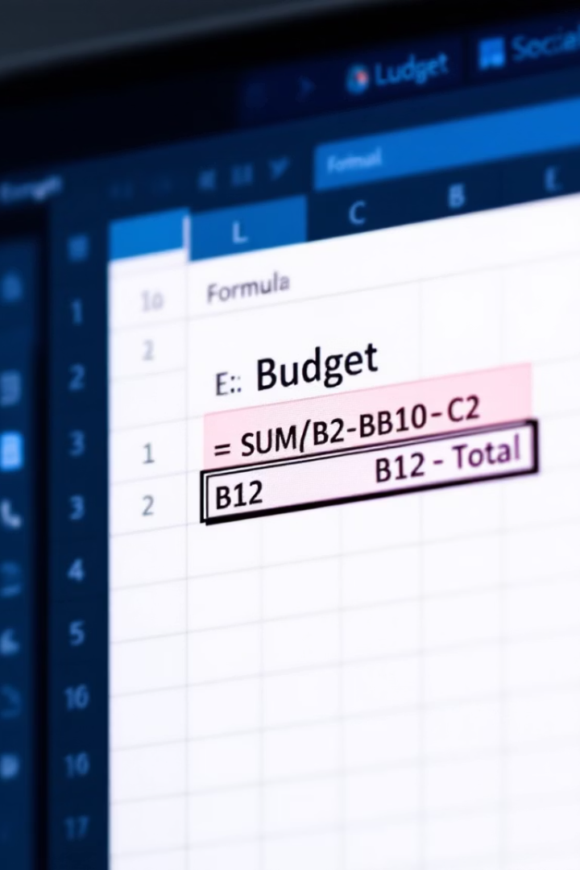



Why Excel for Password Analysis?
Excel is familiar and customizable, without needing extra software or coding experience.
Familiarity
Customizable
No install

Slide 4
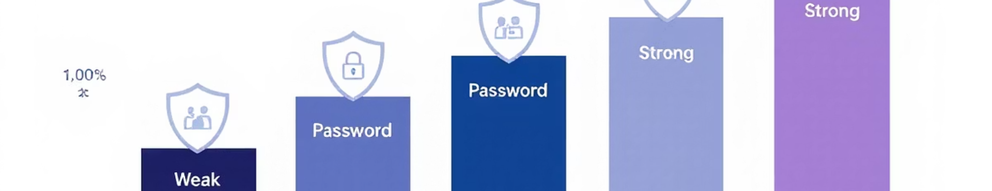
Key Features of the Analyzer
Our analyzer scores passwords based on length, characters, and complexity.
Evaluates Password Attributes
Generates Strength Scores
Identifies Common Sequences
It displays strength levels, such as weak, moderate, or strong.
It tests length, special characters, numbers, and diversity.
The analyzer detects dictionary words or common patterns.

Slide 5
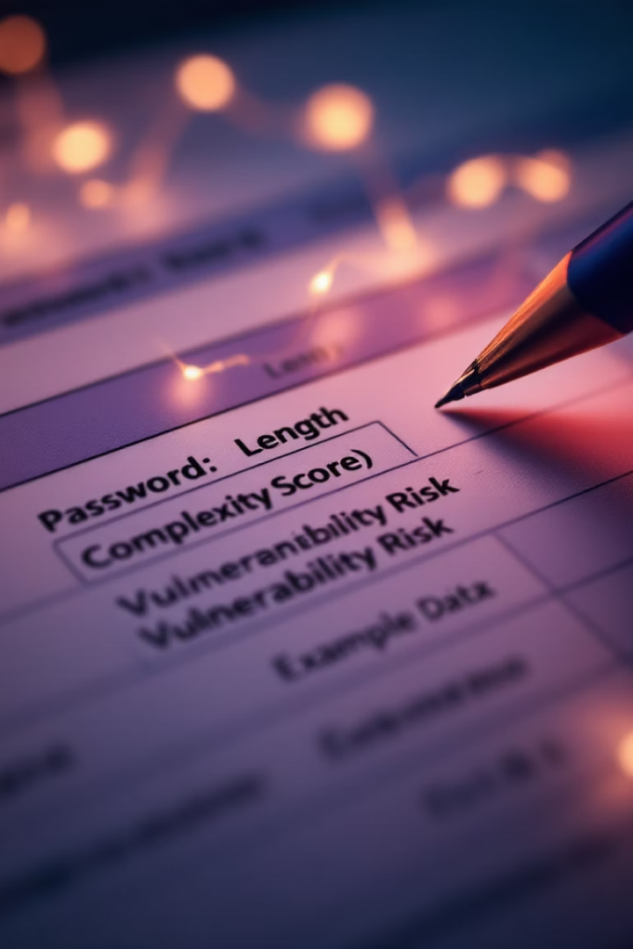
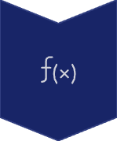


Building the Analyzer: Step-by-Step
Build the analyzer using Excel functions like LEN(), IF(), and REGEXMATCH().
Excel Functions
Utilize LEN(), IF(), REGEXMATCH().
Conditional Formatting
Highlight vulnerabilities.
Integrate VBA
For complex checks.

Slide 6






Benefits of the Password Analyzer
This password analyzer promotes better practices. It can save costs from potential breaches.
Better Practices
Cost Savings
Easy Integration

Slide 7



Limitations and Considerations
Excel dependency affects performance. It is not a substitute for advanced tools.
Excel Dependency
Basic Proficiency
Not a Substitute

Slide 8






Conclusion and Call to Action
Excel is a handy solution for small-scale use. Use pre-made templates and VBA guides for passwords.
Excel Solution
For casual use
Strong Passwords
Resources
Importance for cybersecurity
Templates and guides

Slide 9
Thank you

